Slide 1

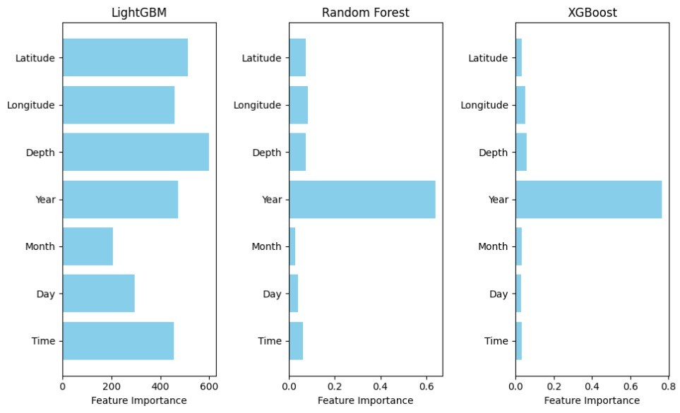
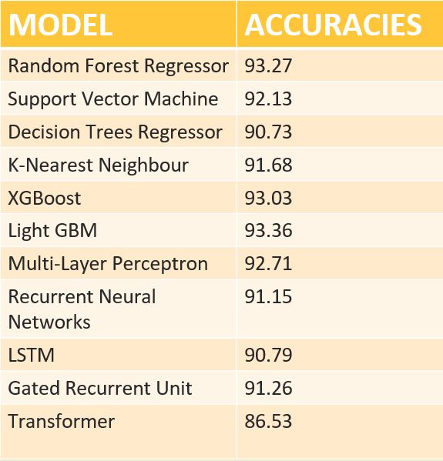
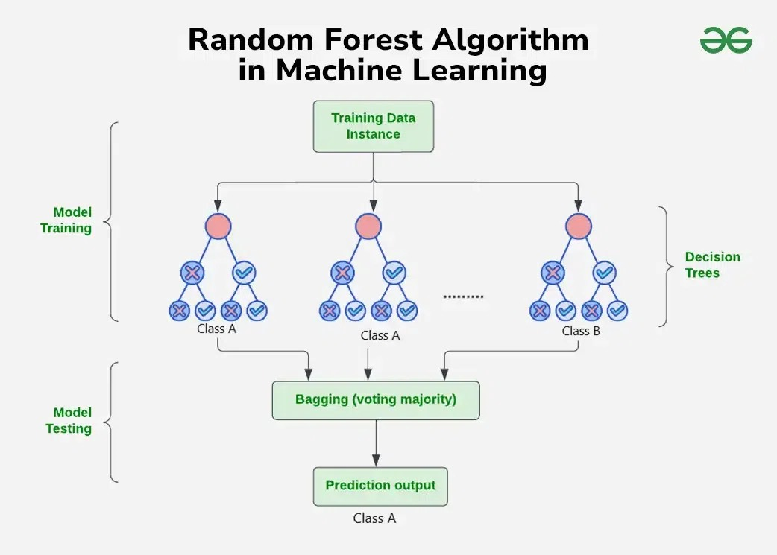
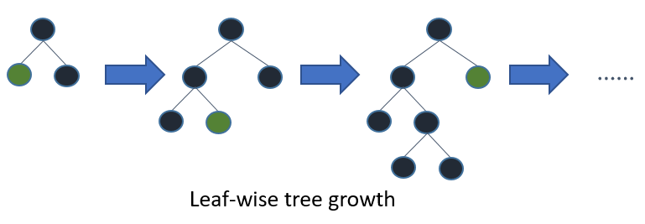
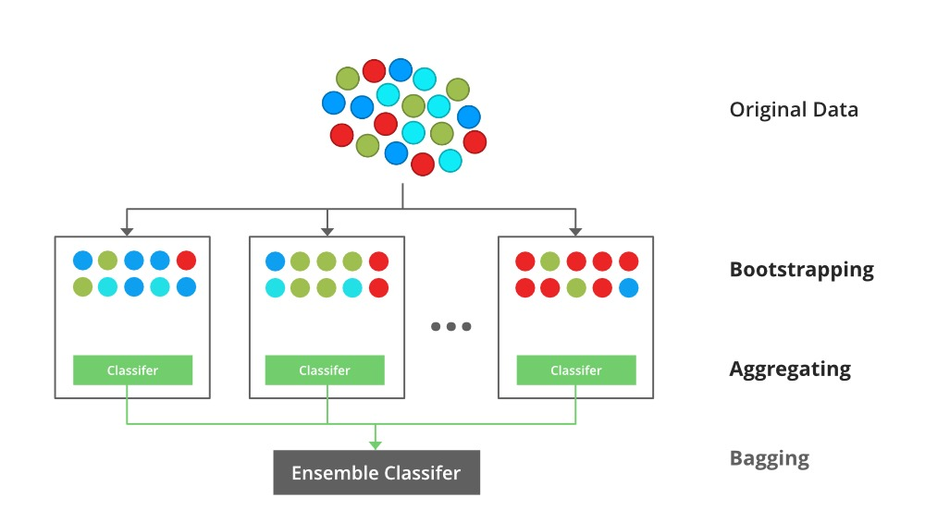

DISASTER RESPONSE AND RECOVERY
Presenter Name - K.K.Charan Reddy, J.Surya, Rahul Chaudhary, M.Pavan
Guide Name – Dr. S.S.Nandini
Introduction
Findings and Results
Earthquake management is still a worldwide challenge because of its unpredictability and destructive effect on life, infrastructure, and economies.
Earthquakes, which are classified as tectonic or volcanic, cause cascading effects like aftershocks, landslides, and tsunamis, making disaster response even more challenging.
This project seeks to improve earthquake prediction through machine learning methods such as decision trees, random forests, XGBoost and LightGBM.
Through the use of data analytics, the system analyzes seismic data to derive patterns and enhance predictive capabilities.
Integrating machine learning into disaster management enhances situational awareness, enables informed decision-making, and assists in preventing risks.
Feature Importance of Top 3 models
Models and its accuracies
Methods
Random forest model algorithm LightGBM algorithm
XGBoost algorithm
Conclusions
This project leverages machine learning models like Decision Trees, Random Forest, LightGBM, and XGBoost for disaster prediction and management. By enhancing prediction accuracy, it serves as an early warning system to minimize disaster impacts. The system processes both historical and real-time data, aiding timely decision-making. Its adaptability to different disaster locations makes it highly effective. This project demonstrates how AI and machine learning can shift disaster management from reactive to proactive, data-driven solutions, helping governments and organizations mitigate losses and strengthen resilience.
Data Analysis
References
Seismic data was gathered from reliable sources such as USGS, local geological offices, and the IRIS website, totaling 3 million global records.
The dataset comprises earthquake magnitude, location, time, and environmental factors.
Methods of data acquisition including USGS Earthquake and learning resources are offered by the SAGA Earthquake website.
Visualization of trends and model performance is aided by Matplotlib and Seaborn. SQL is utilized for querying and efficient management of data.
The data was filtered during download from the mentioned websites to ensure that it did not exceed the from in each magnitude category.
Improving earthquake prediction accuracy in Los Angeles with machine learning:- Cemil Emre Yavas, Lei Chen, Christopher Kadlec and Yiming Ji
Earthquake magnitude predic tion in Hindukush region using machine learning techniques- K. M. Asim1, F. Martı´nez-A ´ lvarez2, A. Basit3, T. Iqbal
Major earthquake event predic tion using various machine learn ing algorithms- Roxane Mallouhy, Chady Abou Jaoude, Christophe Guyeux, Abdallah Makhoul
Earthquake magnitude predic tion in Turkey: a comparative study of deep learning methods, ARIMA and singular spectrum analysis- Hatice ¨ Oncel C¸ekim1, Hat ice Nur Karakavak1, Gamze Ozel1, Senem Tekin
Big data analytics in prevention, preparedness response and recovery in crisis and disaster management- D Emmanouil, D Nikolaos
GITAM SCHOOL OF TECHNOLOGY , CSE
(Guide Name: Dr.S.S.Nandini)

